Slide 1
Statistics concepts
Data Science

Slide 2
Introduction to Optimization
Descriptive Statistics
Gives information that describes the data in some manner.
the term given to the analysis of data that helps describe, show or summarize data in a meaningful way.
Descriptive statistics enables us to present the data in a more meaningful way, which allows simpler interpretation of the data.
Examples: mean, standard deviation, median etc.
A graphical Representation is another method of descriptive statistics e.g., histograms, pie graphs etc.

Slide 3
Introduction to Optimization
Inferential Statistics
Descriptive statistics provide information about our immediate group of data.
However, you do not have access to the whole population you are interested in investigating
Inferential statistics are techniques that allow us to use the samples to make generalizations about the populations from which the samples were drawn.

Slide 4
Introduction to Optimization
Introduction to Research Methods

Slide 5
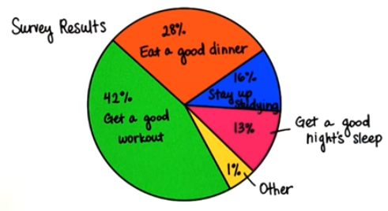
Introduction to Optimization
Believe Results
You have a big exam tomorrow and your memory needs to be as sharp as possible.
What would you do to prepare?
Lets say we conduct a survey

Slide 6
Introduction to Optimization
Believe Results
What information would help you trust these results?
  How many people I surveyed (sample size)
  Who I surveyed (sample representativeness)
  How the survey was conducted (methodology)

Slide 7
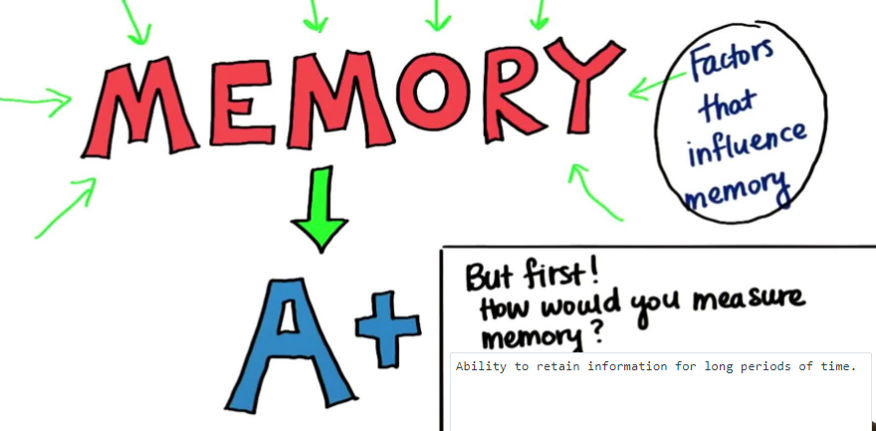
Introduction to Optimization
Measure Memory

Slide 8
Introduction to Optimization
Define Constructs
Memory
Hapiness
Guilt
Different ways of defining and measuring constructs.
BBC Memory Test

Slide 9
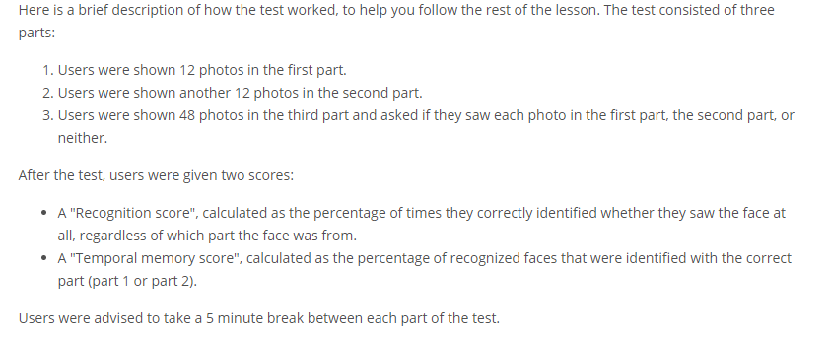
Introduction to Optimization
Define Constructs
BBC Memory Test

Slide 10
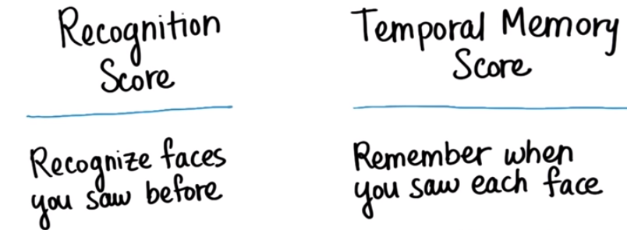
Introduction to Optimization
Define Constructs
BBC scores
We use your data to analyze the Memory construct

Slide 11

Introduction to Optimization
Operational Definition
How did BBC measure memory?

Slide 12
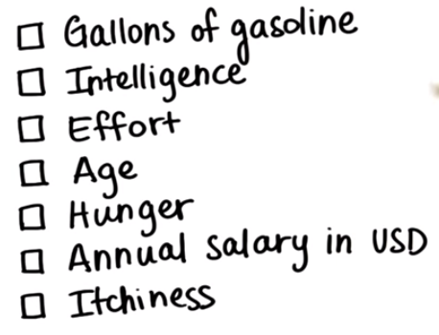
Introduction to Optimization
Constructs
Which are constructs?

Slide 13
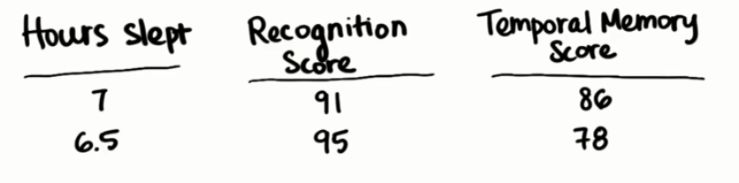
Introduction to Optimization
Data
Q: You have exam tomorrow. Should you get a good night sleep tonight? Does it matter?

Slide 14
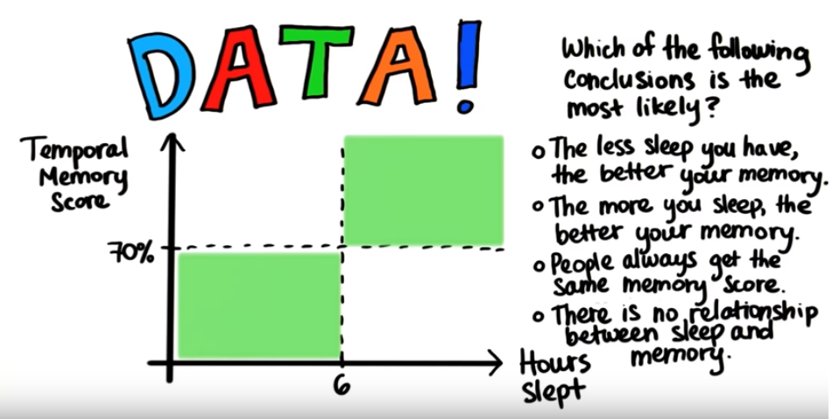
Introduction to Optimization
Data

Slide 15
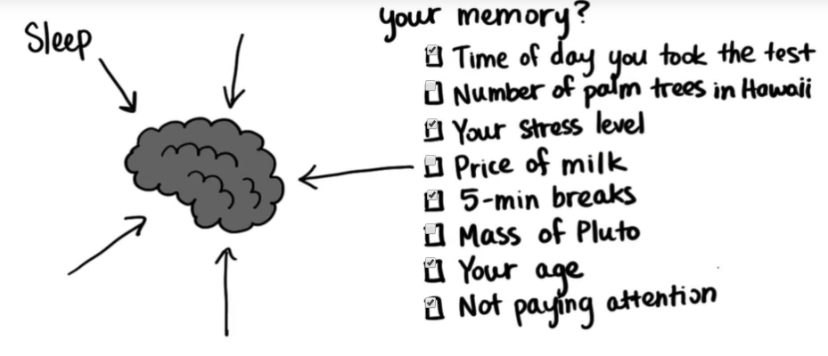
Introduction to Optimization
Influence Memory

Slide 16
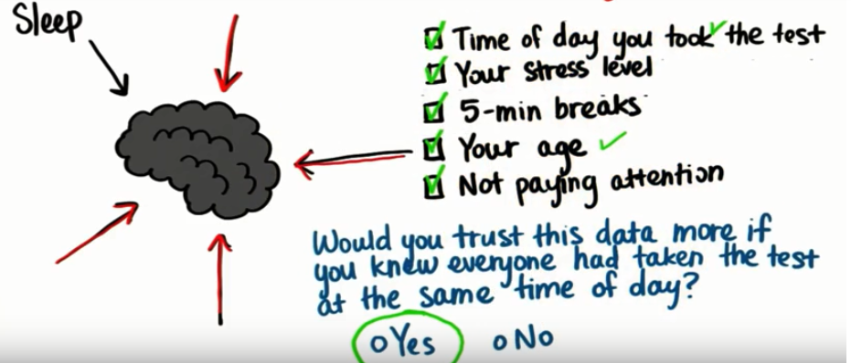
Introduction to Optimization
Other Factors which Influence the Memory
Control for Time of Day
Extraneous Factors (Lurking Variables)

Slide 17
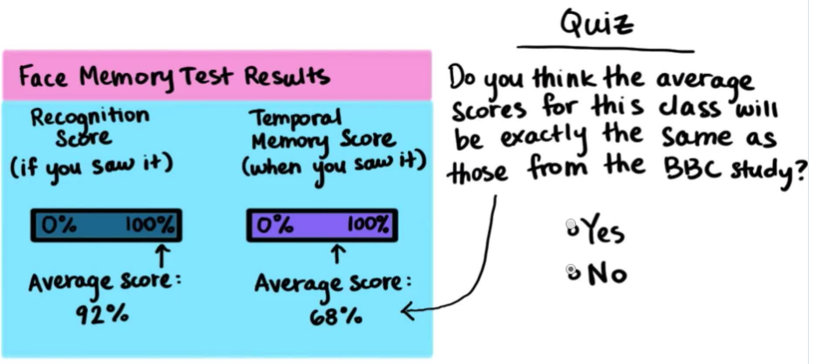
Introduction to Optimization
Population and Sample Average

Slide 18
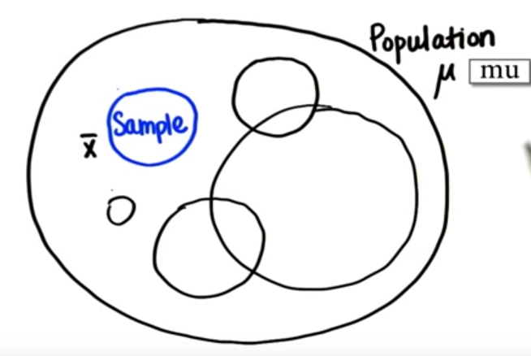
Introduction to Optimization
Population and Sample Average

Slide 19
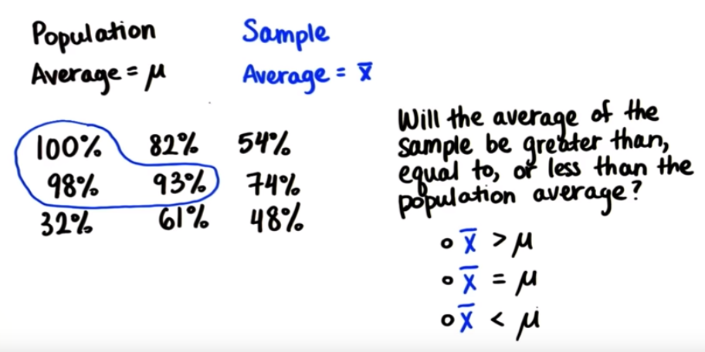
Introduction to Optimization
Sample Average

Slide 20
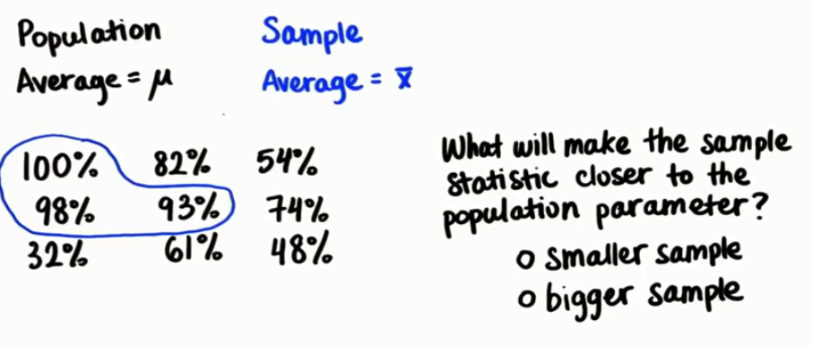
Introduction to Optimization
Better sample

Slide 21
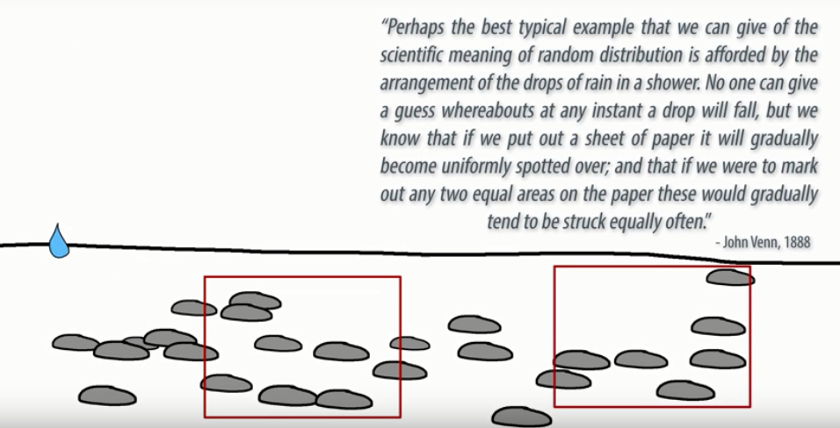
Introduction to Optimization
Randomness

Slide 22
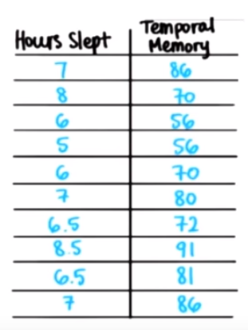
Introduction to Optimization
Visualize Relationship
Is there any relationship between variables?

Slide 23
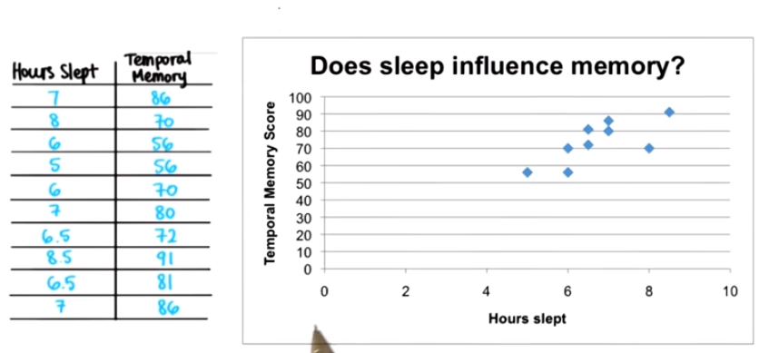
Introduction to Optimization
Visualize Relationship

Slide 24
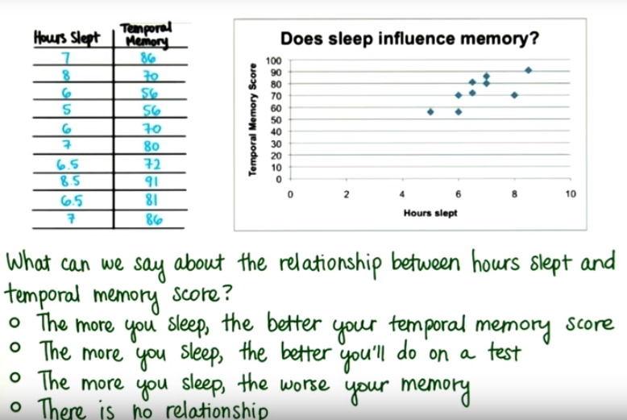
Introduction to Optimization
Visualize Relationship

Slide 25
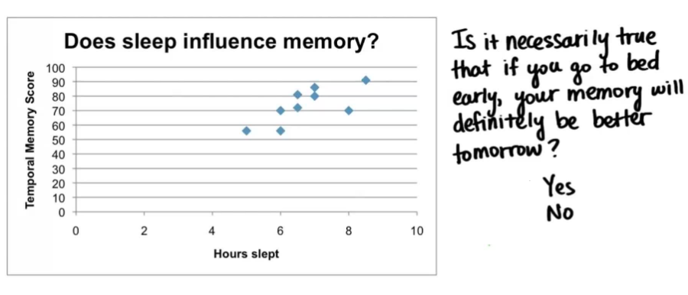
Introduction to Optimization
True or Not

